Slide 1
Heart Disease Detection Using Machine Learning
Detection of HeArt disease early Using Machine Learning

Slide 2
Table of Contents
Objective
Dataset Overview
Data Preprocessing
Model overview and Training
Model Evaluation

Slide 3
Objectives
The objective of the Heart Disease Detection project is to create a machine learning model that can predict whether a person is likely to have heart disease based on their health data. This helps doctors make better decisions and detect heart problems early.

Slide 4
Data Overview
The data overview for the Heart Disease Detection project includes patient details such as age, sex, chest pain type, blood pressure, cholesterol levels, and exercise habits. These features help predict whether a person has heart Disease. The target variable is binary: 0 (no heart disease) or 1 (has heart disease). The dataset includes both numerical and categorical data. It has total 12 features and 918 samples and data downloaded from Kaggle Dataset.

Slide 5
Data Processing
Data preprocessing involves handling missing values, encoding categorical variables, and feature scaling. In this project, there were no missing values in the dataset. The features were scaled using Standard Scaler to normalize the data before feeding it into the machine learning models.
Label Encoding is a technique where each unique category in a categorical variable is converted into a numerical value.

Slide 6
Models
Random Forest Classifier
Gradient Boosting Classifier
XGBoost Classifier
Decision Tree Classifier
K- Nearest Neighbours Classifier
Logistic Regression

Slide 7
Univariate Analysis
Univariate analysis on features

Slide 8
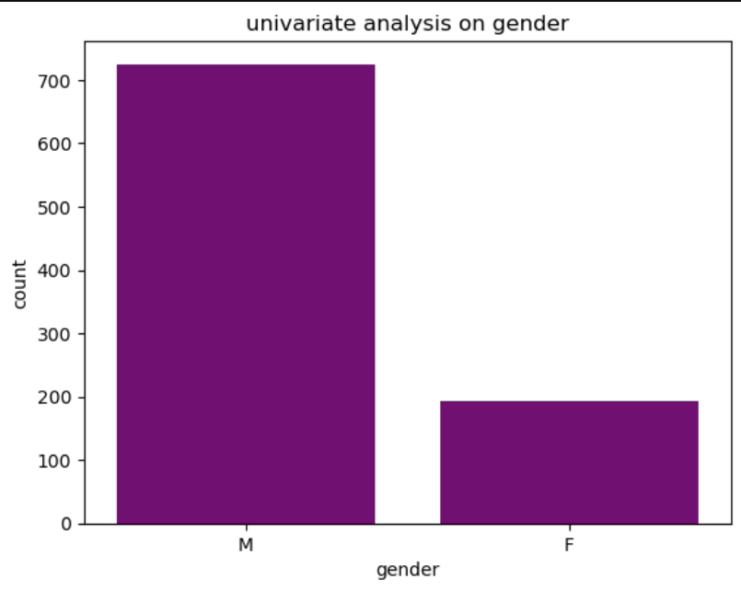

Slide 9
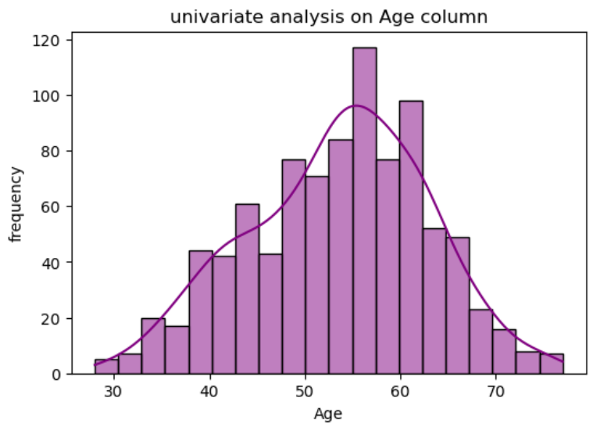

Slide 10
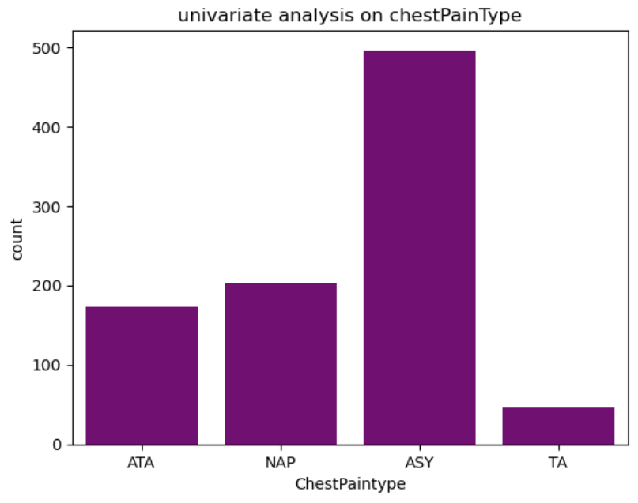

Slide 11
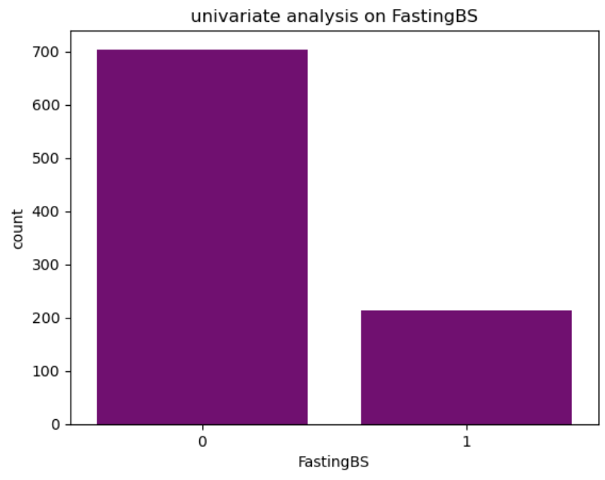

Slide 12
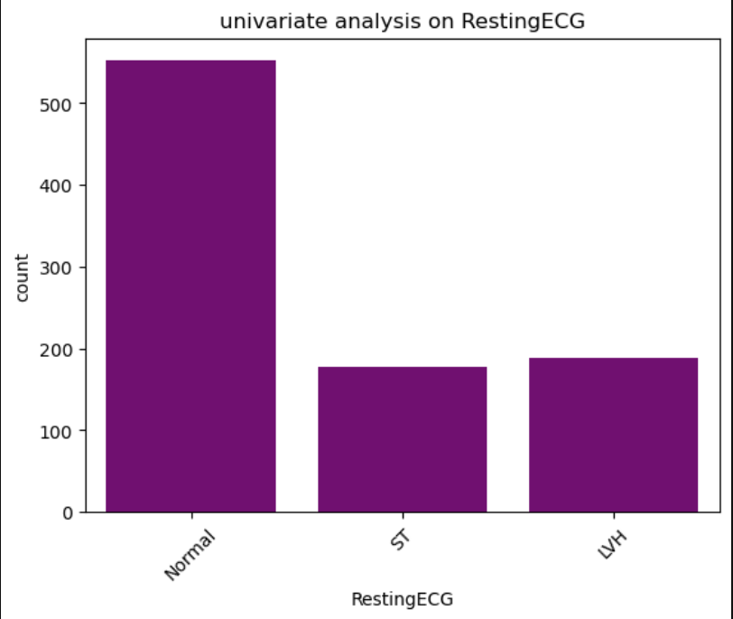

Slide 13
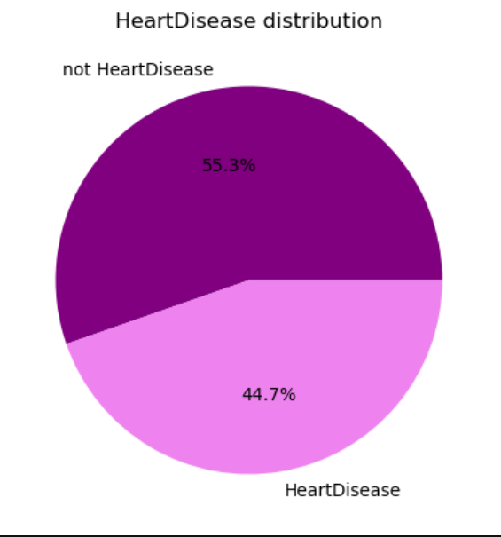

Slide 14
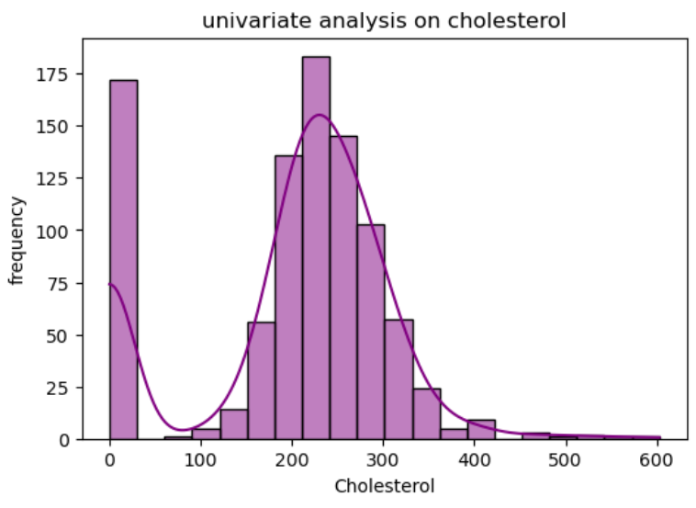

Slide 15
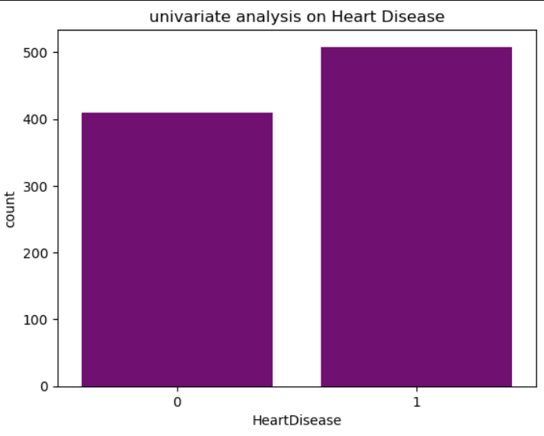

Slide 16
Bivariate Analysis
Bivariate analysis on features

Slide 17
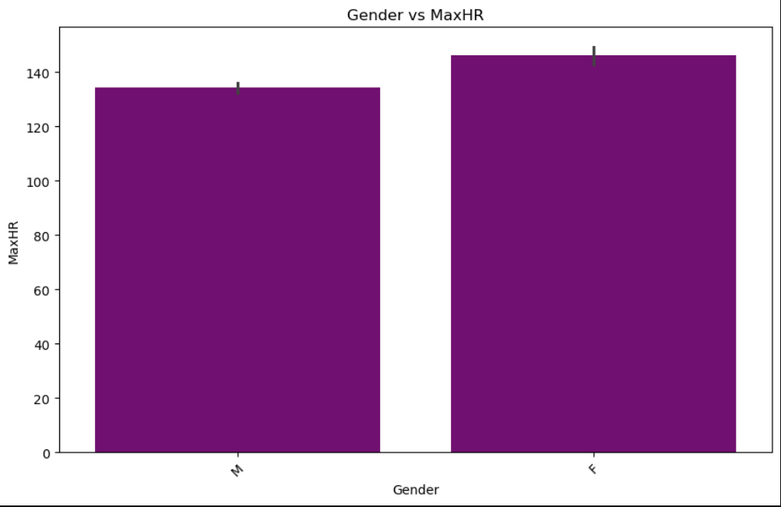

Slide 18
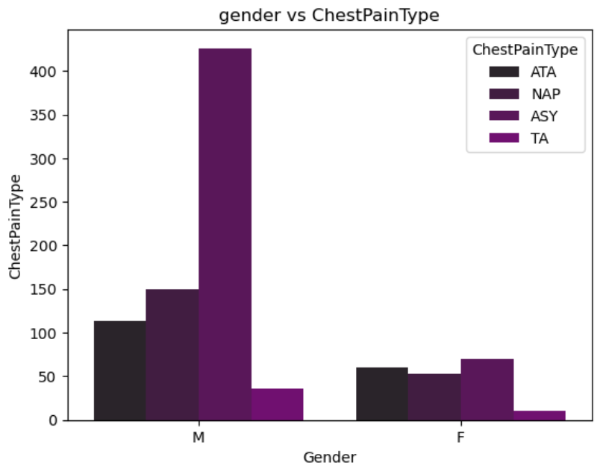

Slide 19
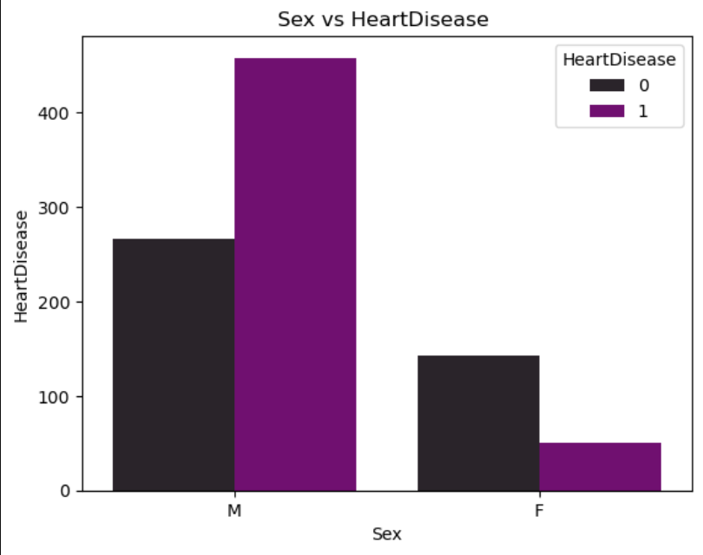

Slide 20
Correlation
correlation

Slide 21
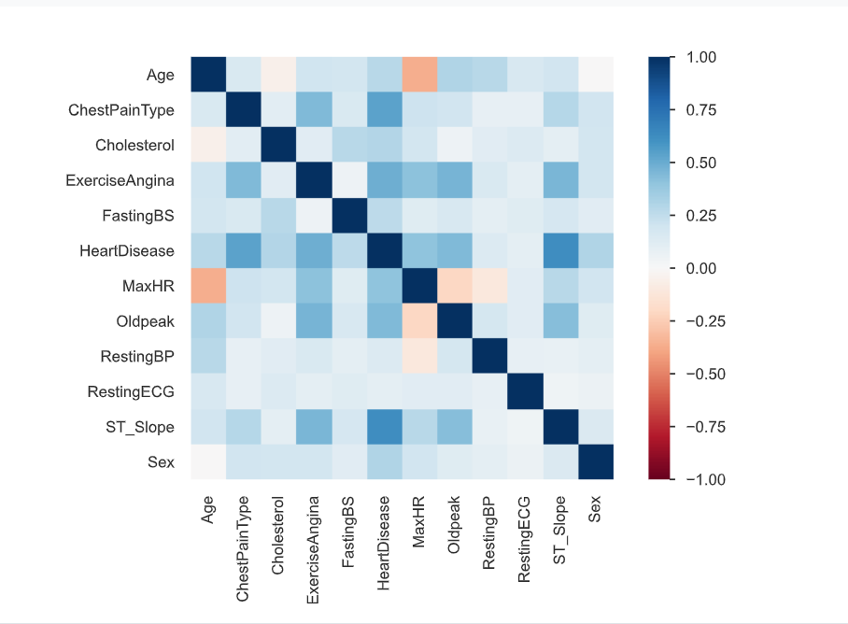

Slide 22
Random Forest Classifier
A Random Forest Classifier is an ensemble machine learning algorithm that combines multiple decision trees to improve accuracy and reduce overfitting. It works by training many decision trees on random subsets of the data and then averaging their predictions (for regression) or using a majority vote (for classification).
Sequential Learning
Loss Minimization
Learning Rate
Regularization

Slide 23
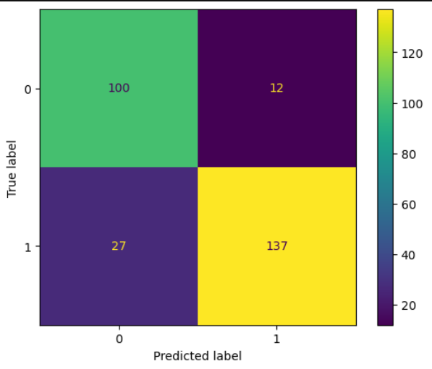
Confusion Matrix

Slide 24
Gradient Boosting Classifier
Gradient Boosting is another ensemble method that builds models sequentially, with each new model correcting the errors of the previous one. The Residuals one decision tree are overcome by another decision tree and all the decision tree other than final tree are weak learners and final decision tree is strong learner.
Sequential Learning
Loss Minimization

Slide 25
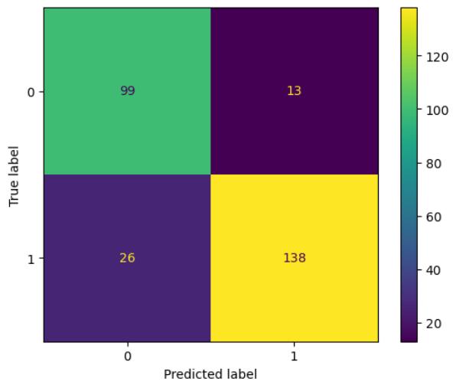
Confusion Matrix

Slide 26
XGBoosting Classifier
Advanced version Gradient Boosting is another ensemble method that builds models sequentially, with each new model correcting the errors of the previous one.
Loss Minimization
Learning Rate
Faster than Gradient Boosting

Slide 27
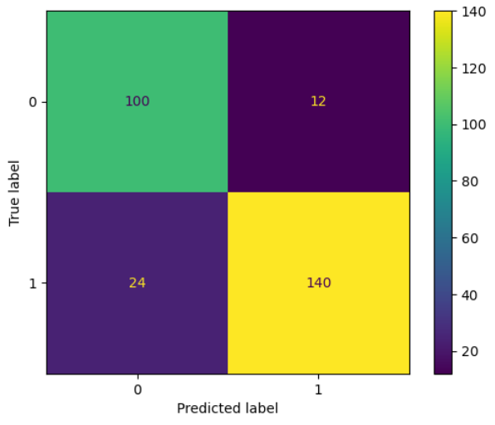
Confusion Matrix

Slide 28
Decision Tree Classifier
A Decision Tree Classifier is a machine learning algorithm that splits data into subsets based on feature values to make predictions. It uses a tree-like structure where each internal node represents a feature (or attribute), each branch represents a decision rule, and each leaf node represents a class label.
Works on categorical and numerical data
Fast Prediction
Non-linear Relationships
Tree Structure

Slide 29
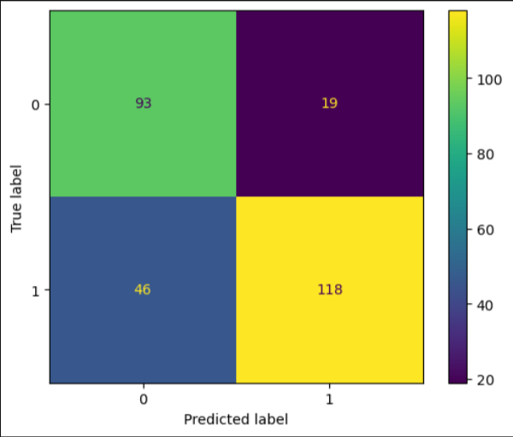
Confusion Matrix

Slide 30
K-Nearest Neighbours Classifier
K-Nearest Neighbors (KNN) is a simple algorithm used for classification and regression. It makes predictions by looking at the 'k' nearest data points to the input and using their majority class (for classification) or average (for regression). It doesn't require training but stores all the data for prediction, and it uses distance (like Euclidean) to find the closest neighbors.
Lazy Learning
Distance Metric
Simple

Slide 31
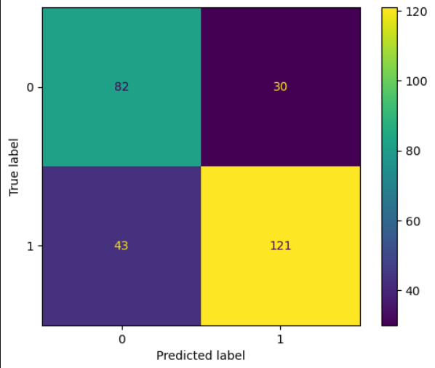
Confusion Matrix

Slide 32
Logistic Regression Classifier
Logistic Regression is a statistical model used for binary classification. It predicts the probability of a target variable being one of two classes. The model uses a logistic function (sigmoid) to map predicted values between 0 and 1.
Binary and multiclass classification
Probability Estimation
Works on continuous and categorical data
Linearity

Slide 33
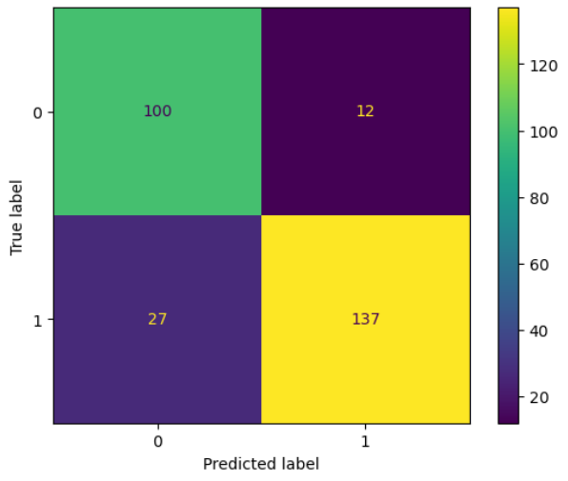
Confusion Matrix

Slide 34
Comparative Analysis of Models
Model | Accuracy | Precision | Recall | F1-score
Random Forest | 0.8586956521739 | 0.92 | 0.84 | 0.88
Gradient Boosting | 0.8586956521739 | 0.91 | 0.84 | 0.88
XGBoost | 0.8695652173913 | 0.92 | 0.85 | 0.89
Decision Tree | 0.7644927536231 | 0.86 | 0.72 | 0.78
KNN | 0.7355072463768 | 0.80 | 0.74 | 0.77
Logistic Regression | 0.8695652173913 | 0.92 | 0.84 | 0.88

Slide 35
Thank You
Sneha Devare

